Slide 1

Automation for Analyzing and Reporting On-farm Research Trials
Brittani Edge
Graduate Research Assistant with Data Intensive Farm Management Project

Slide 2
Data Intensive Farm Management Project
The Data-Intensive Farm Management Project has successfully conducted on-farm field trials in Illinois, Nebraska, Kansas, Ohio, Montana, New York, Louisiana, Texas, Washington, Argentina, Brazil, and South Africa.
Our team is working on tools for designing trials, cleaning data, and analyzing and reporting in a consistent way

Slide 3
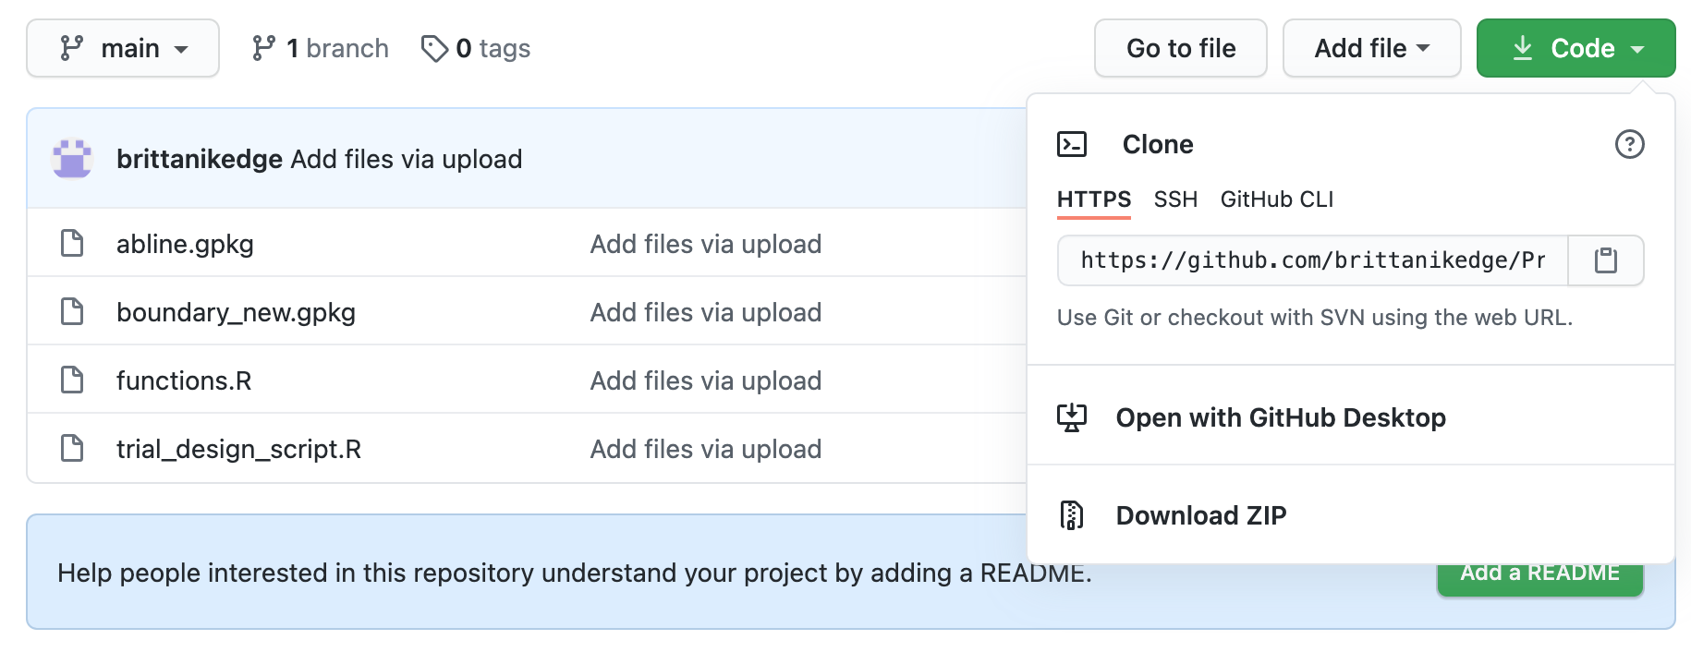
Goals for Today’s Presentation
Think about what goes into cleaning data before analysis
Discuss issues around automation
Learn about what is being done for automation by the DIFM project
Learn about R Markdown for creating reports
This presentation and sample scripts can be found here https://github.com/brittanikedge/Precision-Agriculture-Producer-Materials.
Download the files by clicking the green Code button and select Download ZIP

Slide 4
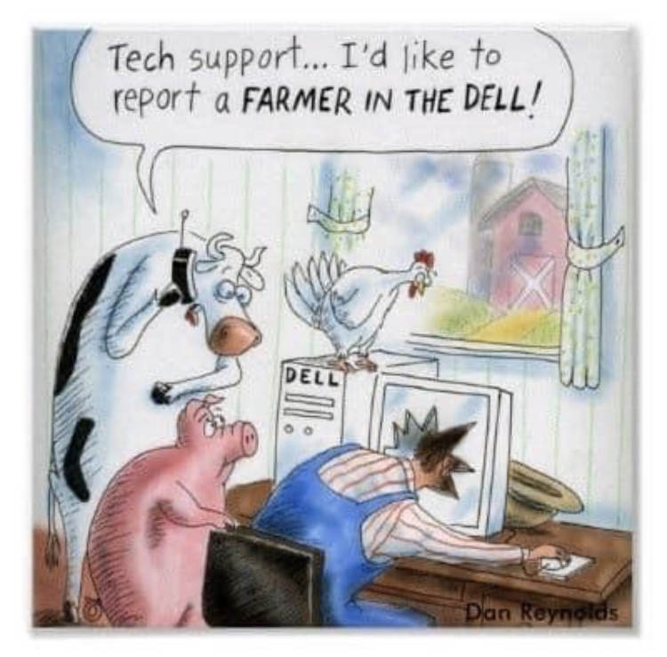
R Resources
The method for designing trials relies on the use of R, a free software available for Mac and Windows.
Below is a guide for downloading R and R Studio on your computer. R Studio is a more user-friendly environment for writing and running R scripts, but you cannot use R Studio without downloading R first!
R Download Source
Learning a new computer program is always frustrating, but there are many resources when you have problems.
And I’m happy to answer any questions you may have!

Slide 5
R Scripts
An R script is a set of instructions that are read each time you want to perform a specific task.
How to Execute R Code
If you download the repository on your personal computer and have downloaded R, you can run the scripts for this lesson with your own data or use the sample field we will see here.

Slide 6
R Markdown
R Markdown is a type of file that allows you to include graphs and plots made in R in a Word document or PDF.
This is very helpful when making trial reports. The DIFM project continues to work on the automation of these reports, but you can learn the basics for your own reports.
Below are links to R Markdown Guides:
https://monashbioinformaticsplatform.github.io/2017-11-16-open-science-training/topics/rmarkdown.html
https://rstudio.com/wp-content/uploads/2015/03/rmarkdown-reference.pdf
https://rmarkdown.rstudio.com/docs/articles/rmarkdown.html

Slide 7
Plot-Based Data Cleaning
Remove outliers
Remove the transition zones
Remove headlands
Split into subplot and aggregate the cleaned data inside the subplots
Transition area
Removal of the outliers, transition areas, and any points outside of plot
Subplots with the median value of yield and nitrogen points in the area
Subplot 1
Subplot 2
Outliers
Subplot 3
Subplot 4
Transition area

Slide 8
Challenges with Old Method
Length of Transition Zone – The time and thus length required for the yield monitor to adjust to new levels or for the sprayer to spray a new rate will depend on the machinery type and age. Due to lack of information, this length is often determined by a researcher. We used to use 30 meters.
Misapplication - Cutting up the original trial plot does not allow for misalignment issues. For example, the producer may have started harvesting at the edge of the plot rather than a quarter of the way inside.
However, there are many kinds of misalignment and misapplication errors with different implications for data cleaning.

Slide 9
Misapplication Examples
These yield observations did not receive the nitrogen rate seen in the plot
This is the most challenging case as you have the machinery switching rates and zones much faster than intended
These yield observations came from two different nitrogen applications
1. Example with misaligned nitrogen application
2. Example with misaligned harvesting
3. Example with wrong farming direction in design

Slide 10
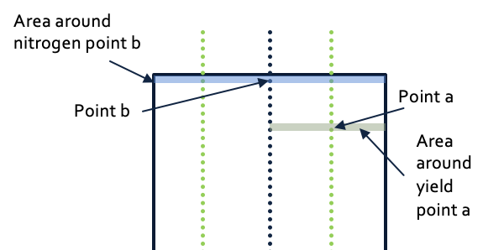
Why does Misalignment Matter?
A good yield measurement comes from a harvest area that was all given the same treatment.
If there was a misalignment, the harvester is collecting partially from an area with a different treatment.
Then the yield value reported is the average of the yield from the two different treatment.
This presents a challenge when analyzing the effect of treatments.

Slide 11
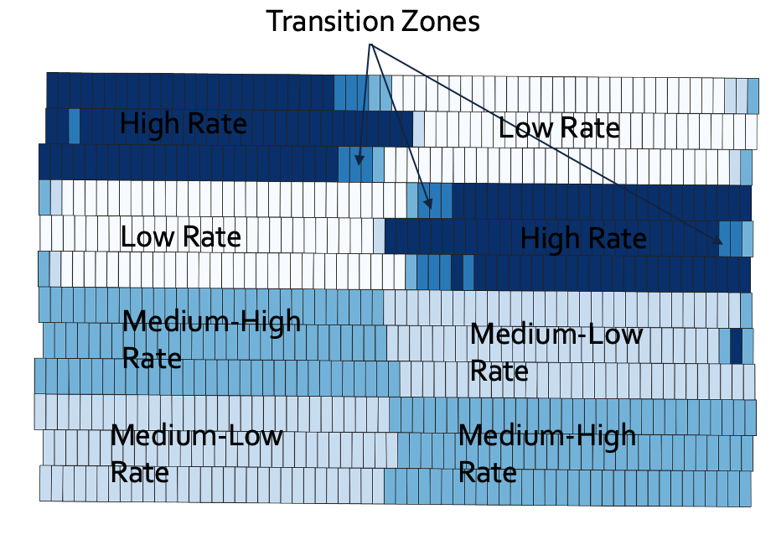
Data Cleaning Using the As-applied Data
We create polygons from the as-applied point data and we can see the transitions from one trial rate to the next
We can use that information along with yield polygons to clean the data

Slide 12
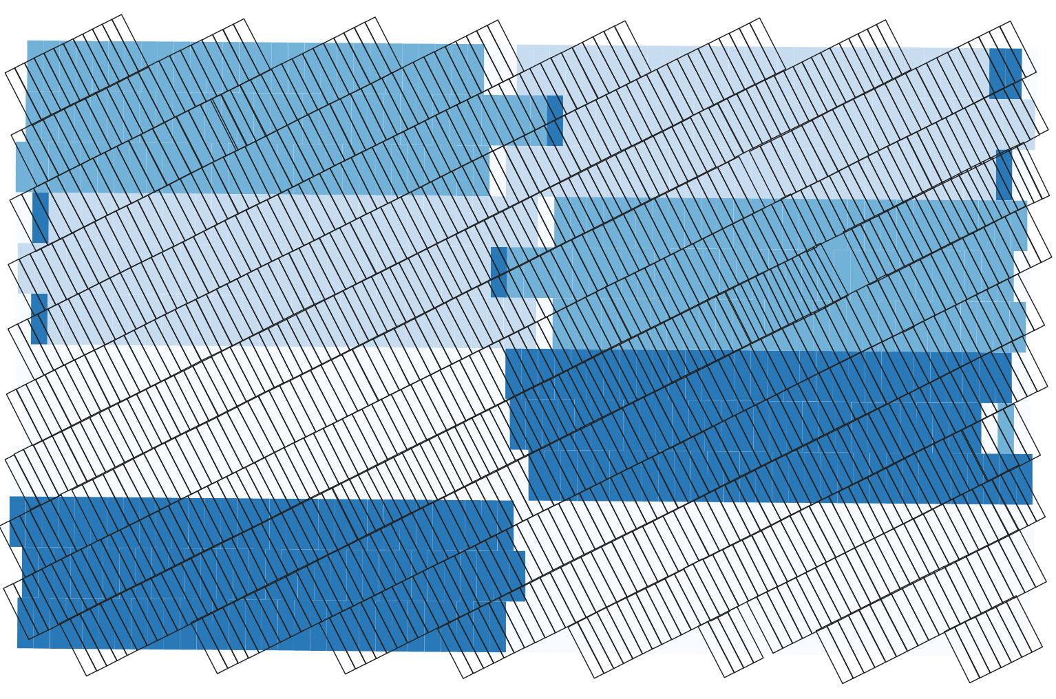
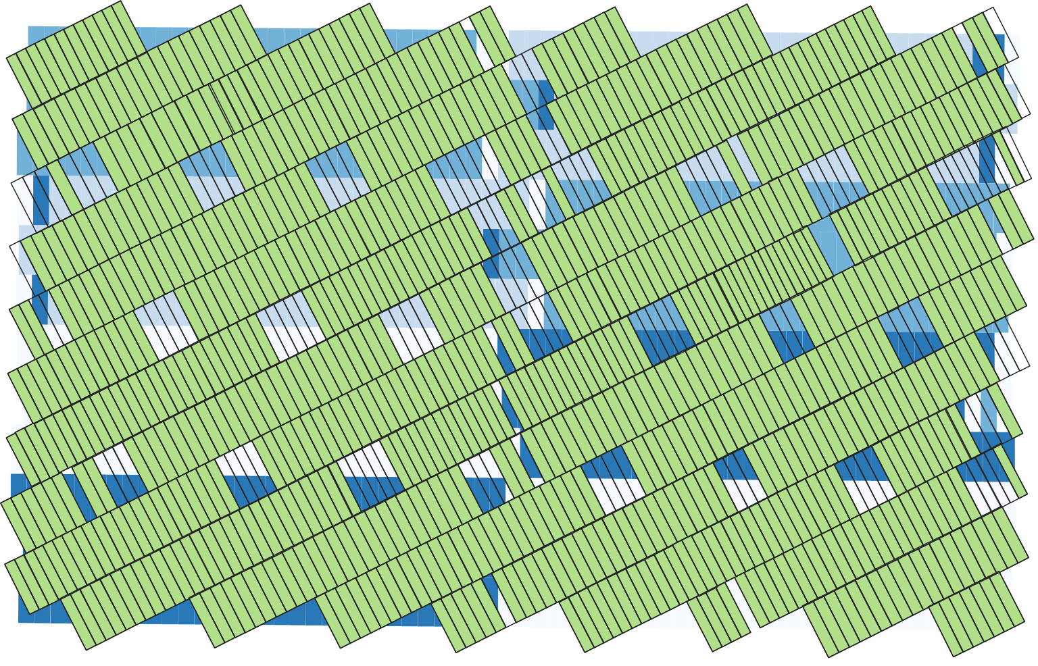
Grouping the Yield Polygons
The blue areas are the seed clusters, and the black grid are yield polygons. We can see where some of the problematic areas are going to be from this map.
Green polygons are the yield polygons with 70% of the area in one cluster. We can see the edges of the plots are removed due to the difference in driving direction.

Slide 13
Analysis
Once you have cleaned trial data, you are ready for analysis!
Here are some topics to consider:
Important Characteristics - Are there soil or field characteristics you believe will impact the yield response?
Trial Design – Was the trial completely randomized, or was the trial based on a prescription map?
Past Trials- If there was a past trial on the field, you should include those applications as a control

Slide 14
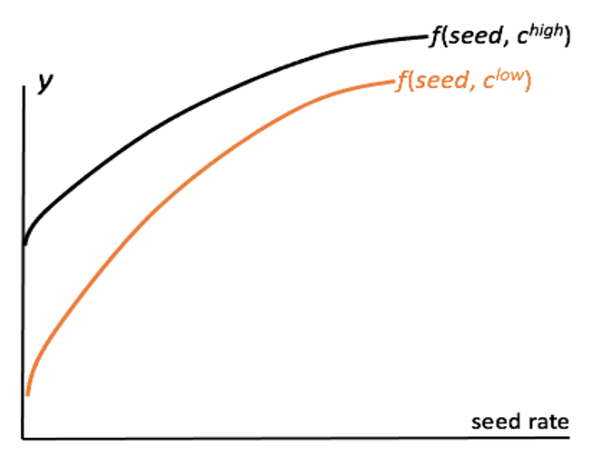
Important Characteristics
The graph to the right shows the yield response to seed at two different levels of a characteristic.
This is the sort of difference we are looking for when we are interested in creating optimal maps.
If you believe certain characteristics are impacting the yield response to an input, this should be included in the analysis.

Slide 15
Trial Design
Make sure you keep record of how the trial was designed
If the trial used different rates in each management zone, then you need to include the management zone in the analysis.
This also means that you can analyze the treatments within the zones, but this trial design doesn’t allow you to test whether the field was zoned correctly.

Slide 16
Automation
Automation takes human intervention out of a specific task
Automation requires consistent inputs and desired outputs
An automated task needs to be able to handle any scenario you might encounter

Slide 17
Automation
Challenges of Automation
What We Are Working On
Different variables across trials
Different names for key variables across datasets
Deciding what analysis results you want to show
Automated reports need a very clear outline before creation
Automated text requires the establishment of decision rules regarding significance of results etc.
Storing all trial information in a table that can be accessed when the trial is cleaned or analyzed
A library with common names seen in harvest and asapplied data
Choices for different tables and graphs to be shown in analysis and reports

Slide 18
Thank you!
I’m happy to take any additional questions, comments, or concerns!

